Slide 1

Chapter 7
Artificial Neural Networks

Slide 2
[Artificial] Neural Networks
A class of powerful, general-purpose tools readily applied to:
  Prediction
  Classification
  Clustering
Biological Neural Net (human brain) is the most powerful – we can generalize from experience
Computers are best at following pre-determined instructions
Computerized Neural Nets attempt to bridge the gap
  Predicting time-series in financial world
  Diagnosing medical conditions
  Identifying clusters of valuable customers
  Fraud detection
  Etc…

Slide 3
Neural Networks
When applied in well-defined domains, their ability to generalize and learn from data “mimics” a human’s ability to learn from experience.
Very useful in Data Mining…better results are the hope
Drawback – training a neural network results in internal weights distributed throughout the network making it difficult to understand why a solution is valid

Slide 4
Neural Network History
1930s thru 1970s
1980s:
  Back propagation – better way of training a neural net
  Computing power became available
  Researchers became more comfortable with n-nets
  Relevant operational data more accessible
  Useful applications (expert systems) emerged
Check out Fair Isaac (www.fairisaac.com) which has a division here in San Diego (formerly HNC)

Slide 5
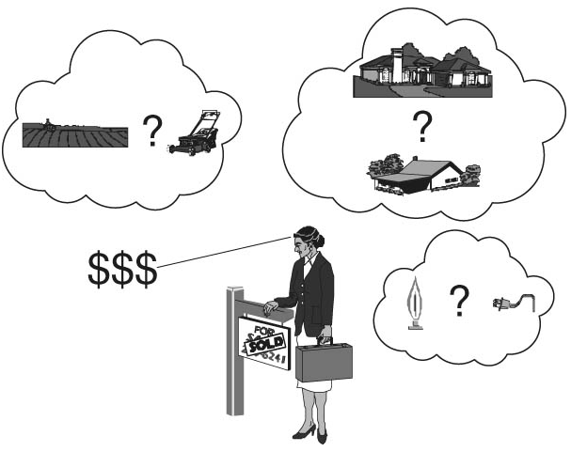
Real Estate Appraiser

Slide 6
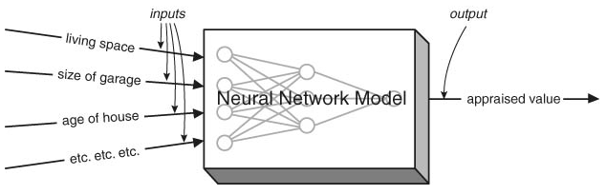
Loan Prospector – HNC/Fair Isaac
A Neural Network (Expert System) is like a black box that knows how to process inputs to create a useful output.
The calculation(s) are quite complex and difficult to understand

Slide 7
Neural Net Limitations
Neural Nets are good for prediction and estimation when:
  Inputs are well understood
  Output is well understood
  Experience is available for examples to use to “train” the neural net application (expert system)
Neural Nets are only as good as the training set used to generate it. The resulting model is static and must be updated with more recent examples and retraining for it to stay relevant

Slide 8
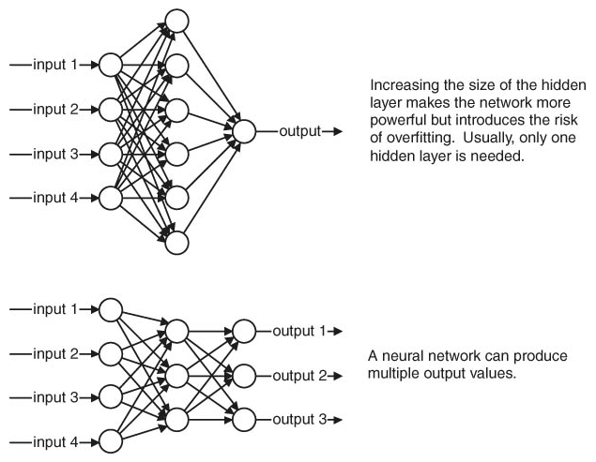
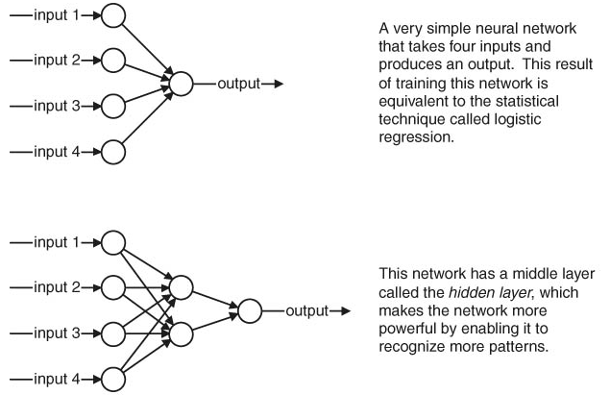
Feed-Forward Neural Net Examples
One-way flow through the network from the inputs to the outputs

Slide 9
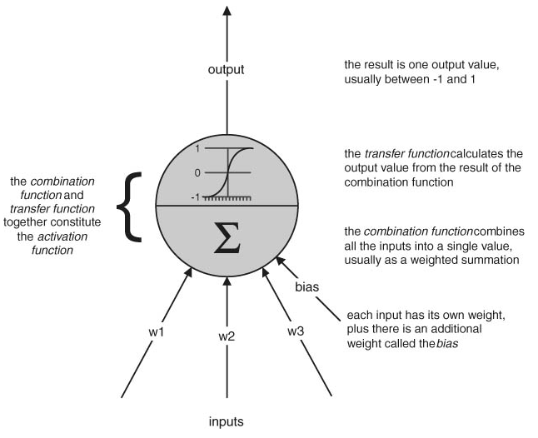
The Unit of a Neural Network
The unit of a neural network is modeled on the biological neuron
The unit combines its inputs into a single value, which it then transforms to produce the output; together these are called the activation function
This is cool stuff!

Slide 10
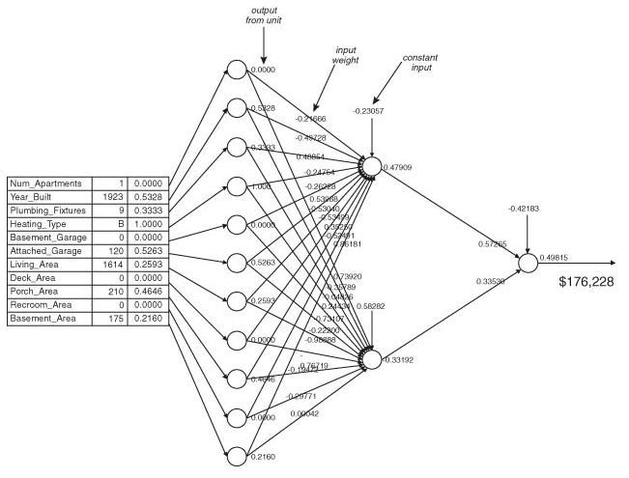
Loan Appraiser - revisited
Illustrates that a neural network (feed-forward in this case) is filled with seemingly meaningless weights
The appraised value of this property is $176,228 (not a bad deal for San Diego!)

Slide 11
Neural Network Training
Training is the process of setting the best weights on the edges connecting all the units in the network
The goal is to use the training set to calculate weights where the output of the network is as close to the desired output as possible for as many of the examples in the training set as possible
Back propagation has been used since the 1980s to adjust the weights (other methods are now available):
  Calculates the error by taking the difference between the calculated result and the actual result
  The error is fed back through the network and the weights are adjusted to minimize the error

Slide 12
Example
Voice Recognition

Slide 13
In-Class Exercise
Search the web for a Neural Net Example
Provide me with the link and we can review in-class

Slide 14

End of Chapter 7

